Slide 1
Object Oriented Programming

Slide 2
POP VS OOP
Procedure-oriented Programming(POP) and Object-oriented programming(OOP) both are the programming approaches, which uses high-level language for programming
The main focus of POP is on “how to get the task done” using functions. So it follows the flow chart to get the task done.
Simply, Procedure oriented programming (POP) is a set of functions.

Slide 3
Need of OOPS
This is the reason why every modern programming language uses OOPS concept, simply because it makes the things simpler and easier to understand which is a great help for programmer.
OOP provides a clear modular structure for programs
OOP makes it easy to maintain and modify existing code
OOP provides a good framework for code libraries where supplied software components can be easily adapted and modified by the programmer.
Code Reusability
It is suitable for real word problems and real world works

Slide 4
Need of OOPS
We try to solve real world issues with help of programs.
In real world everything is a object
Every human or any item we can treat as an object and every object is contain data(attributes) and behavior
Object is like a container which mimics the human brain.
OOPS allows us to create code that is repeatable and organized.

Slide 5
OOPS
Object oriented programming allows user to create their own objects that have methods and attributes.
Remember after defining string, list, dictionary, or other objects your were able to call methods off of them with the .method name() syntax.
These methods act as functions that use information about the objects, as well as the object itself to return results or change the current object.

Slide 6
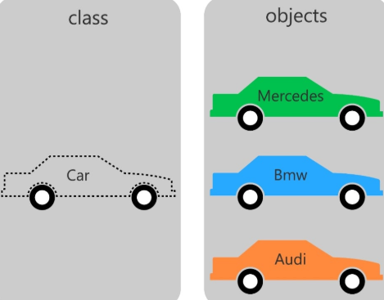
Class vs Objects:

